Slide 1
Thank You Judges!
Sixth Annual Photo Contest
Laura Dachel
Kim Drehmel
Brittany Savignac
Missy Schuh
Ginny Shoemaker

Slide 2

Kent Smith

Slide 3
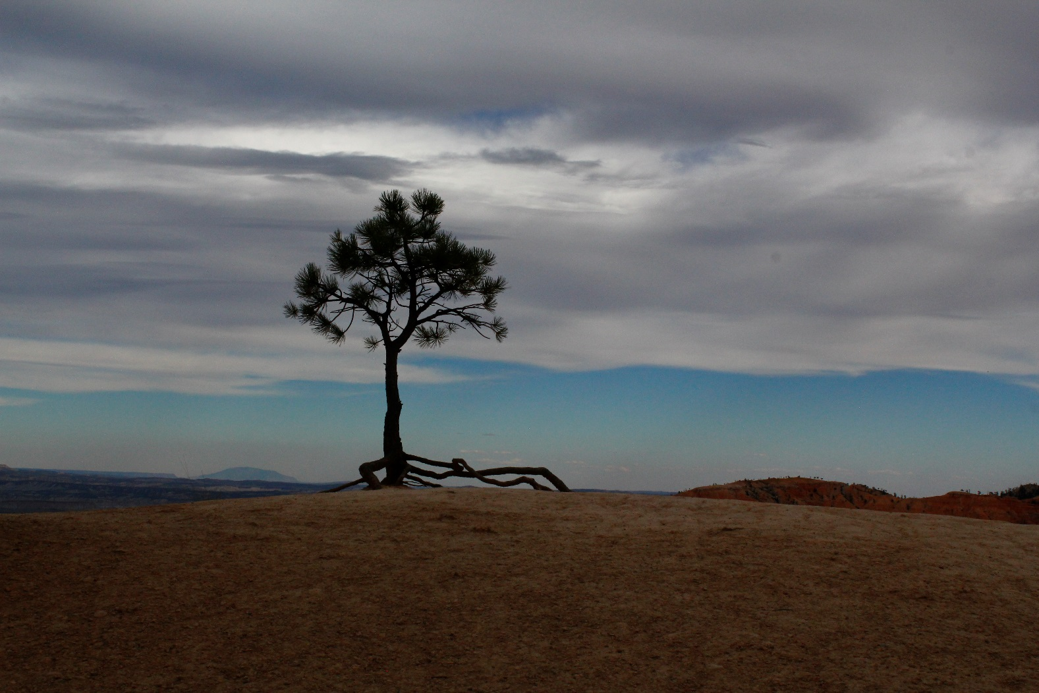
Claudia Cooper-Salm

Slide 4
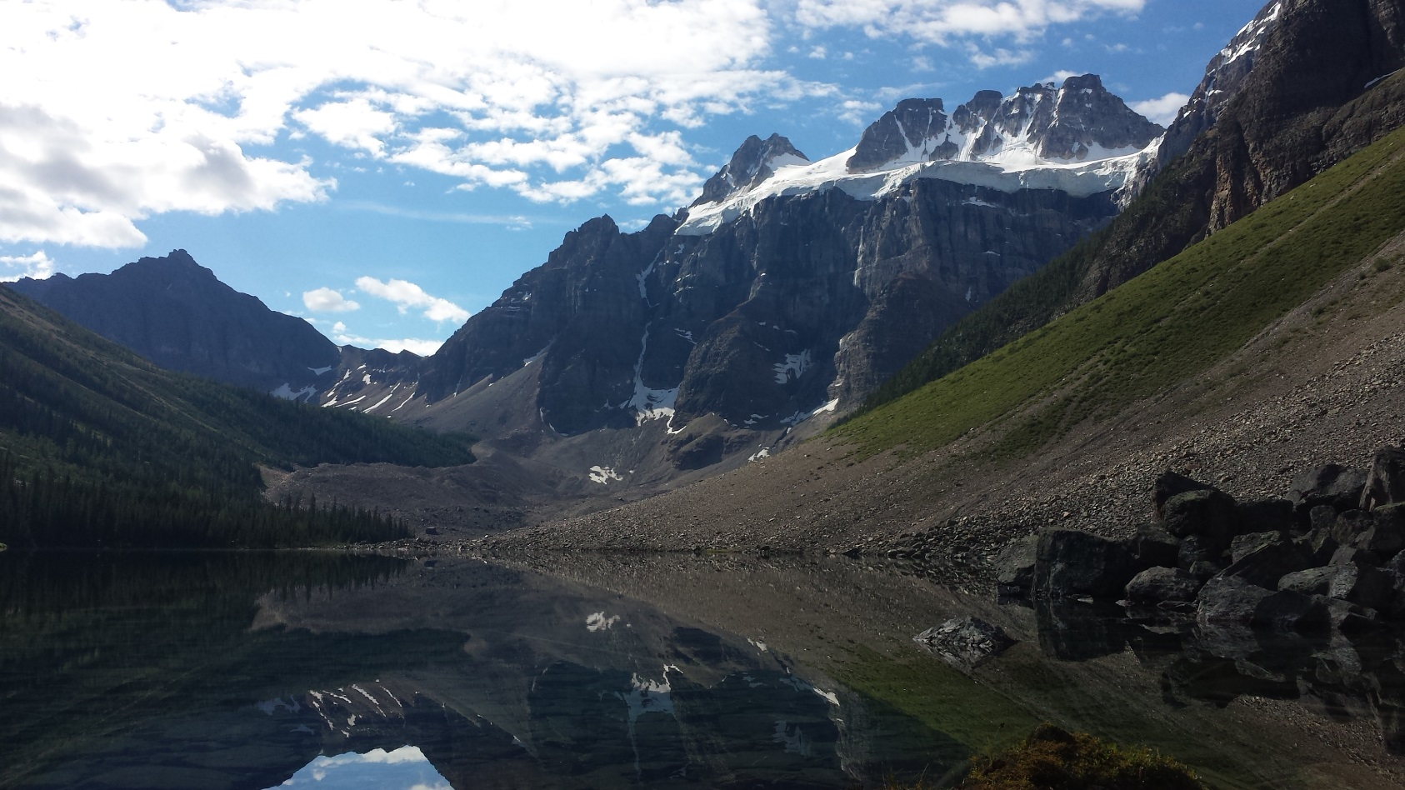
Todd Wanous

Slide 5
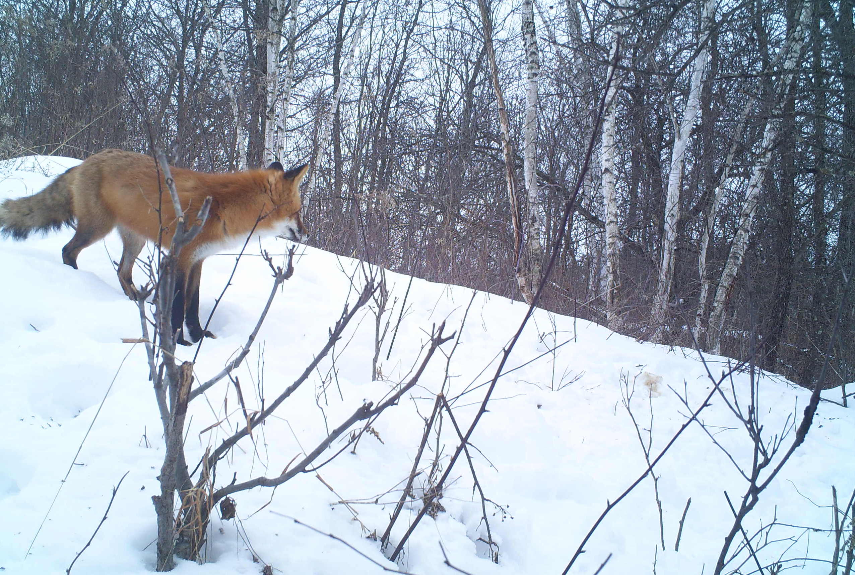
Isaac Walters

Slide 6

Mary Jo Hanson

Slide 7
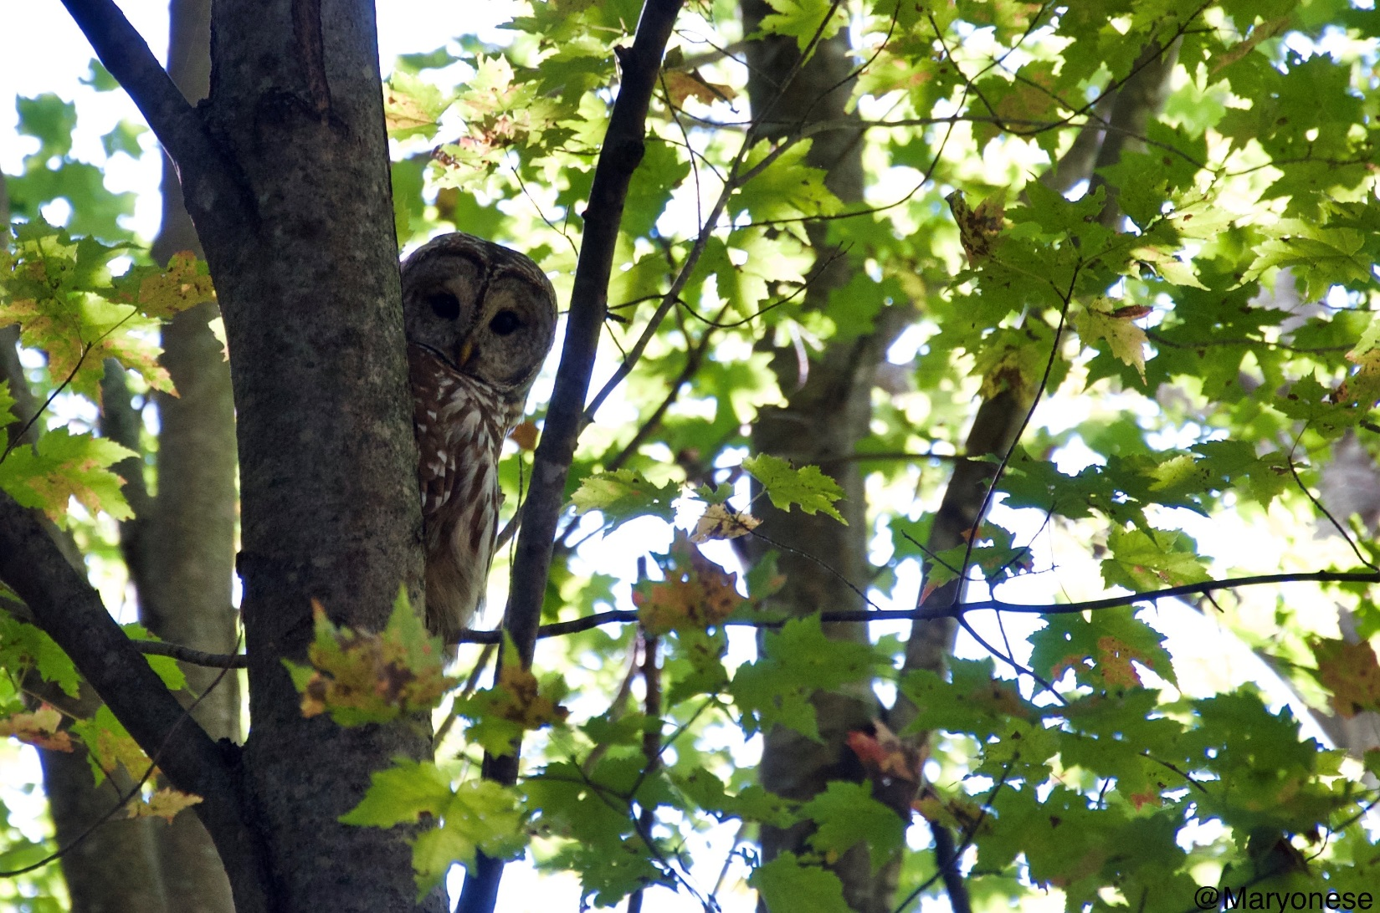
Karen Whitmire

Slide 8
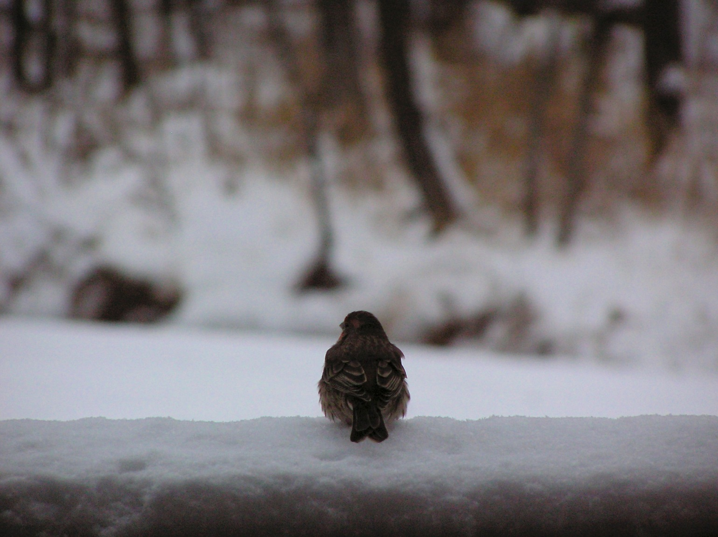
Diane Plantz

Slide 9
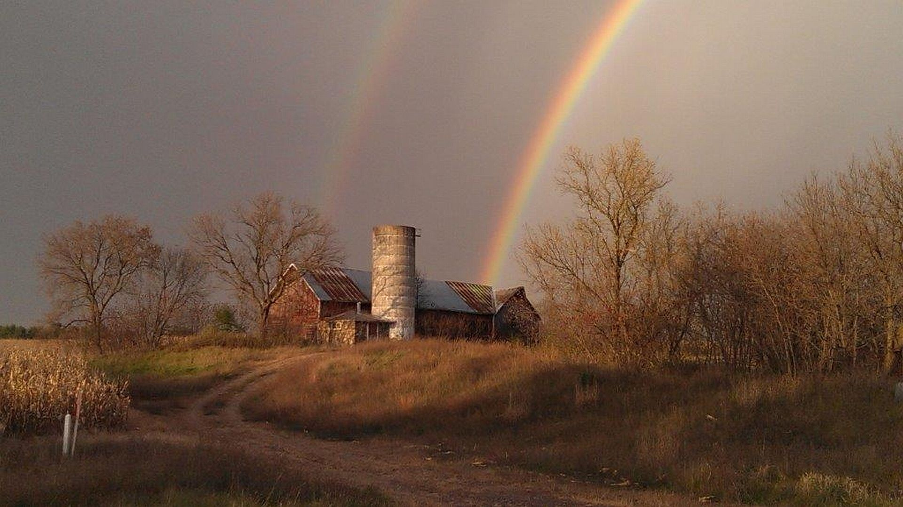
Stacey Boehm

Slide 10
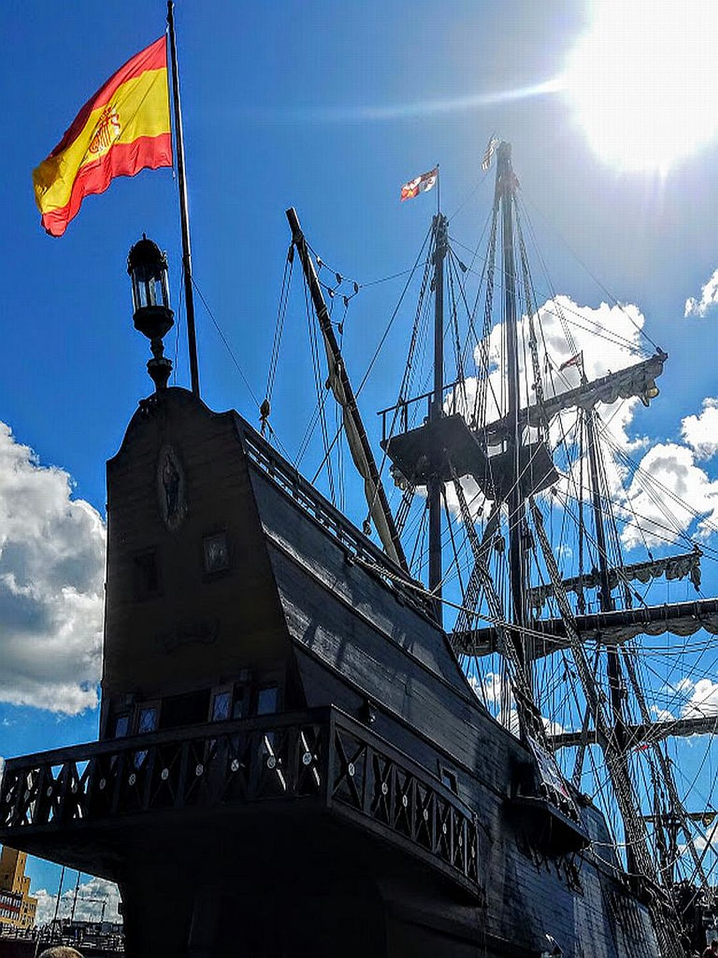
Heather Feigum

Slide 11

Angie Sommers

Slide 12
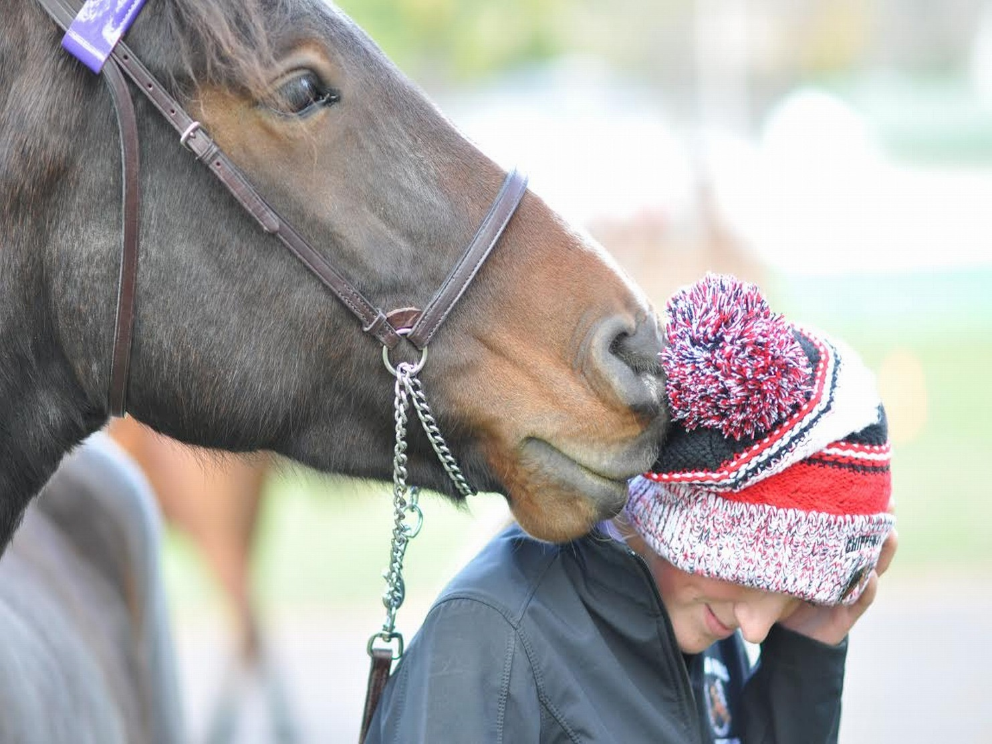
Kari Bowe

Slide 13

Kate Higley

Slide 14

Neil Johnson

Slide 15
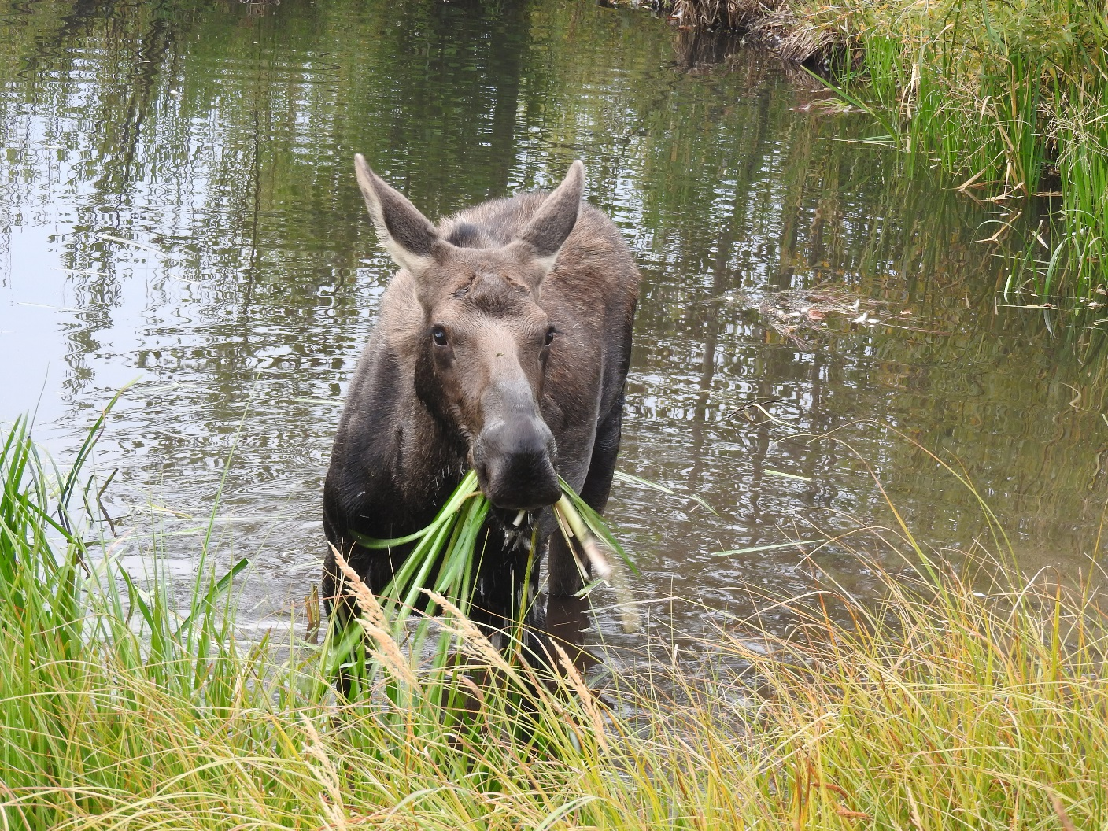
Doreen Stansbury

